Slide 1
DOGWOOD ROAD BRIDGE REPLACEMENT OVER CENTRAL MAIN CANAL BR. NO. 58C-0226
COUNTY OF IMPERIAL PROJECT NO. 6222 PRE-BID MEETING
Date: April 4th, 2022

Slide 2
Agenda
Introductions
Project Overview
Project Components
IID Construction
AT&T Construction
SoCal Gas Sequence of Construction
Additional Request for Information
Questions / Open Discussion
Site Walk

Slide 3
Introductions
Project Entities and Key Team Members
John Gay, Public Works Director
Veronica Atondo, Deputy Director-Engineering
Robert Ureña III, Civil Engineer Assistant II
Sameer Patel (The Holt Group)
Jack Abcarius, Design Engineer (NV5)
Carlos Beltran (Dynamic Consulting Engineers)
David Beltran ( Dynamic Consulting Engineers)
Energy Department:
Said Ambriz, Project Manager
Water Department:
Olivia Alcaraz, Engineer
Deborah McGarrey, Public Affairs Manager
Aaron Pintado, Project Manager
Robert Hartsock (Campos EPC, LLC)
Robert Olide (Campos EPC, LLC)
Jose Chavez (West Land Group)
Dustin Smith (Snelson Co.)
Daniel Garcia, AT&T Mgr Osp Engrg Design

Slide 4
Project Overview
Background
The existing bridge has settled along with the surrounding area at an approximate rate of 1-inch per year, however the surface elevation of the canal has remained constant. Therefore, the freeboard at bridge has been eliminated.
The continuous soil settlement of the zone has significantly increased the risk of road flooding at the Dogwood Road Bridge over the Central Main Canal resulting in a hazardous condition to the motoring public crossing the bridge.

Slide 5
Project Overview
Background
Central Main Canal serves as one of the County’s principal water conveyance facilities for agricultural and residential purposes. It is critical that the bridge be replaced and elevated to allow for optimum water conveyance that will better serve the County and reduce the risk to the motoring public.

Slide 6
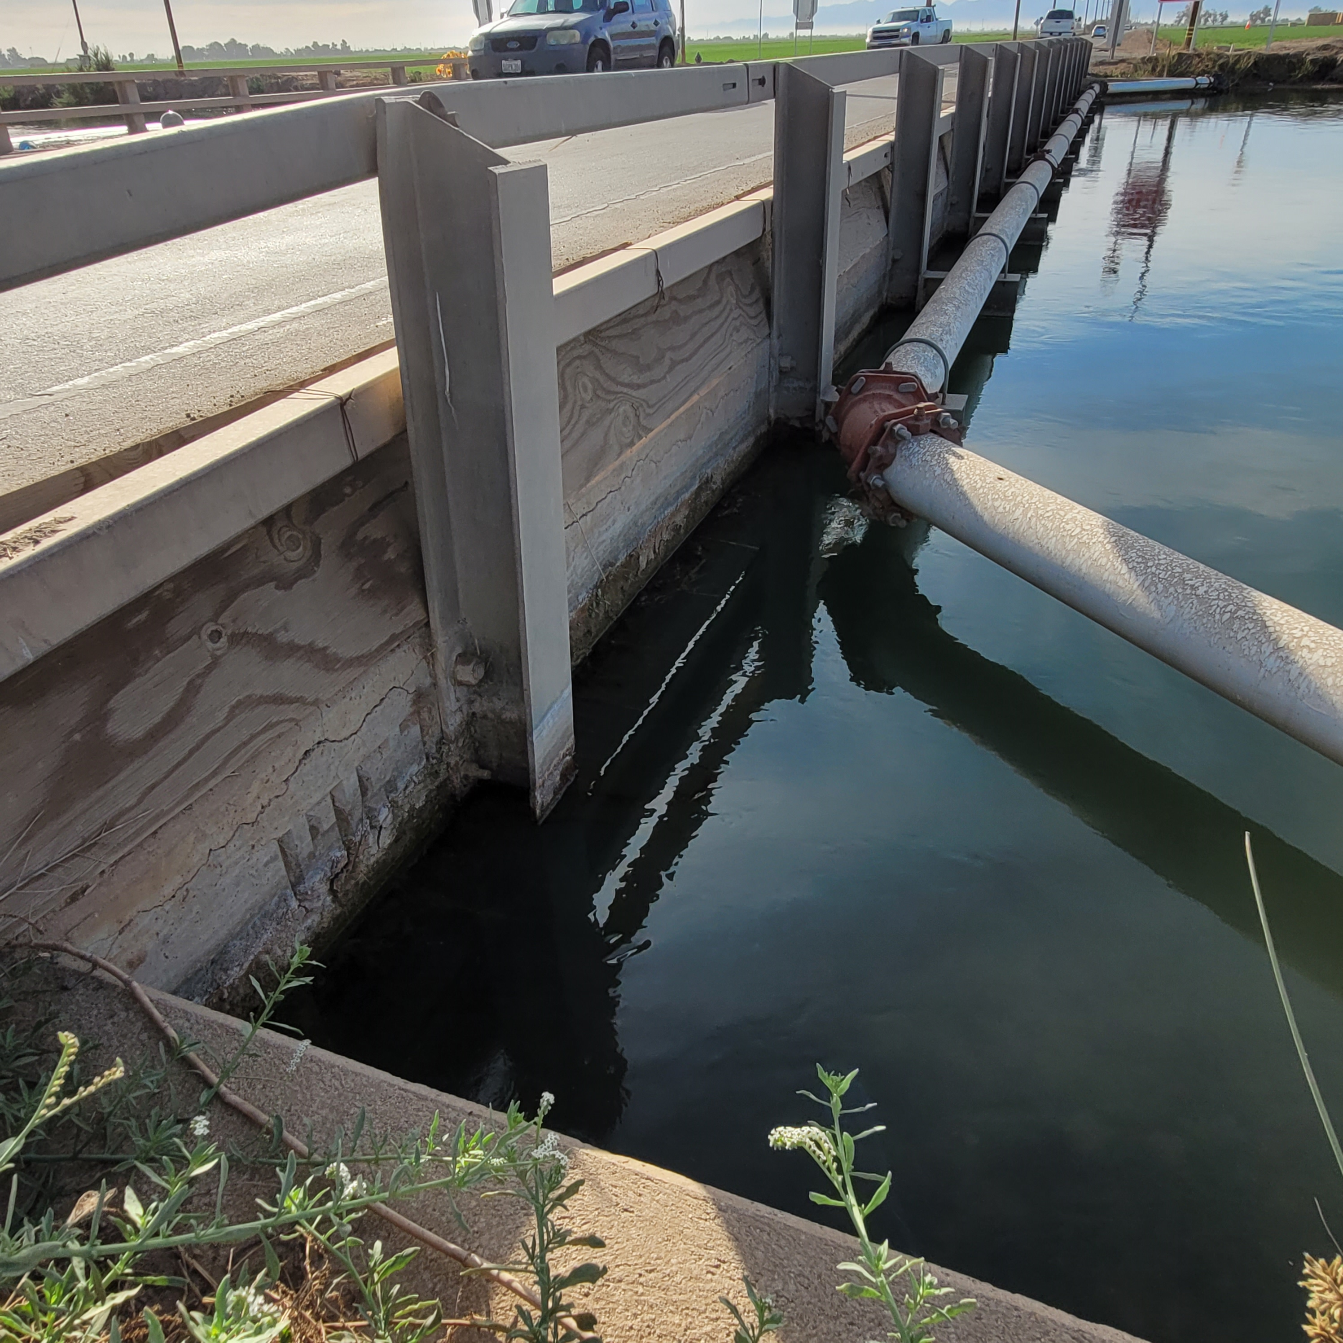
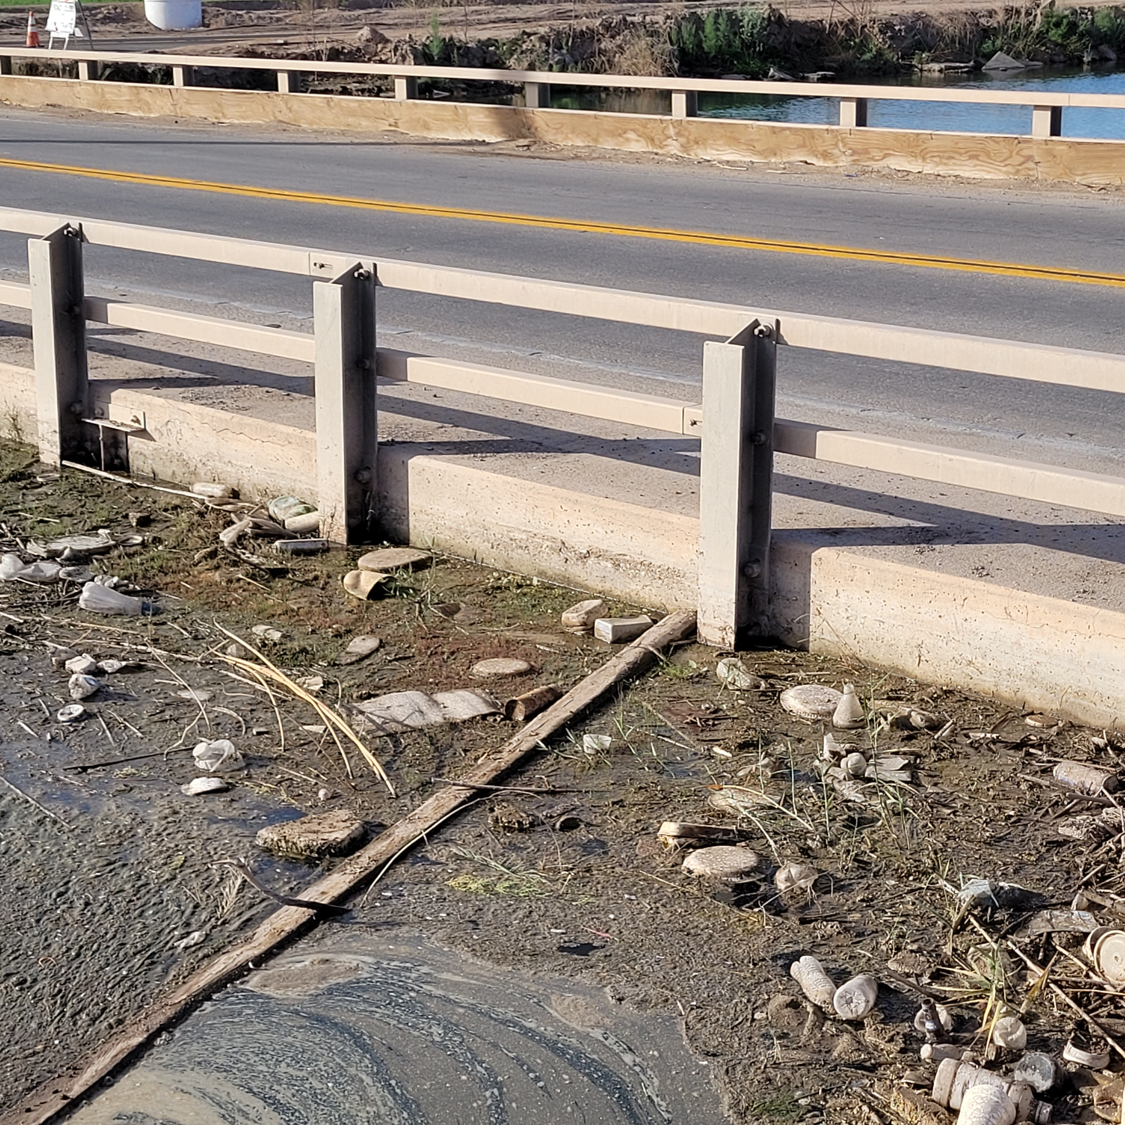
Project Overview
Background

Slide 7
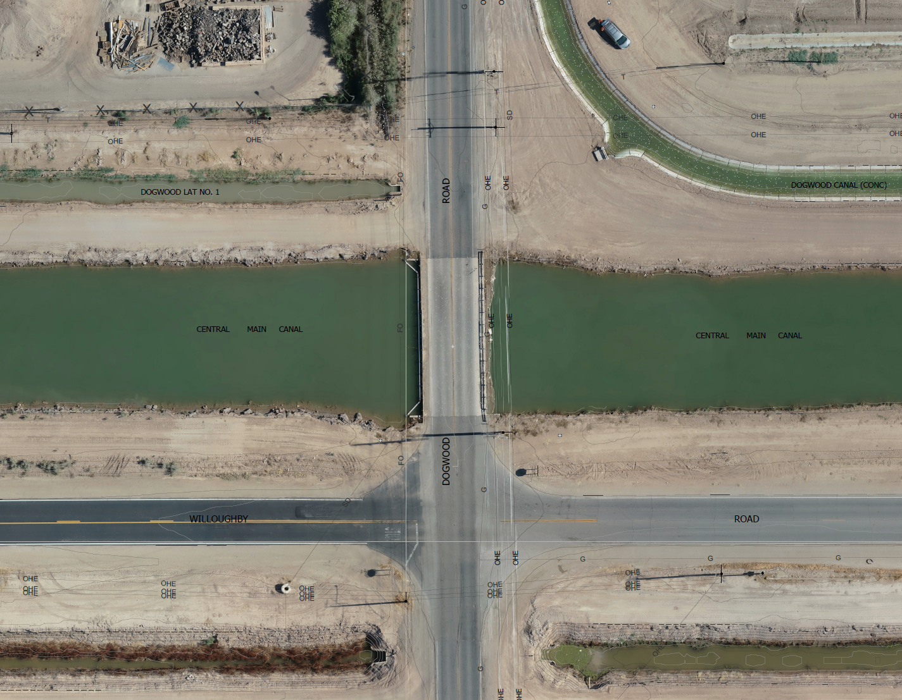
Project Location
(Bridge No. 58C-0226)
DOGWOOD LAT. No. 1
ROAD
DOGWOOD CANAL (CONC)
CENTRAL MAIN CANAL
CENTRAL MAIN CANAL
DOGWOOD
WILLOUGHBY
ROAD

Slide 8
Project Overview
Proposed Plan
Removal and Replacement of the Existing bridge. Existing abutments, wingwalls, and abutment piles are to remain in place.
Existing Bridge span to be removed to accommodate the installation of Prefabricated Steel Press-Brake Formed Tub Girders. Reinforced concrete footings and abutments are to be installed.
Drive sheet piles behind the existing abutment and backfill voids with structure backfill.
Cast-in-Steel-Shell (CISS) Piles to be installed.
Asphalt concrete pavement, class 2 aggregate base, guardrail system, alternative crash cushion, concrete barriers, and paint traffic striping.

Slide 9
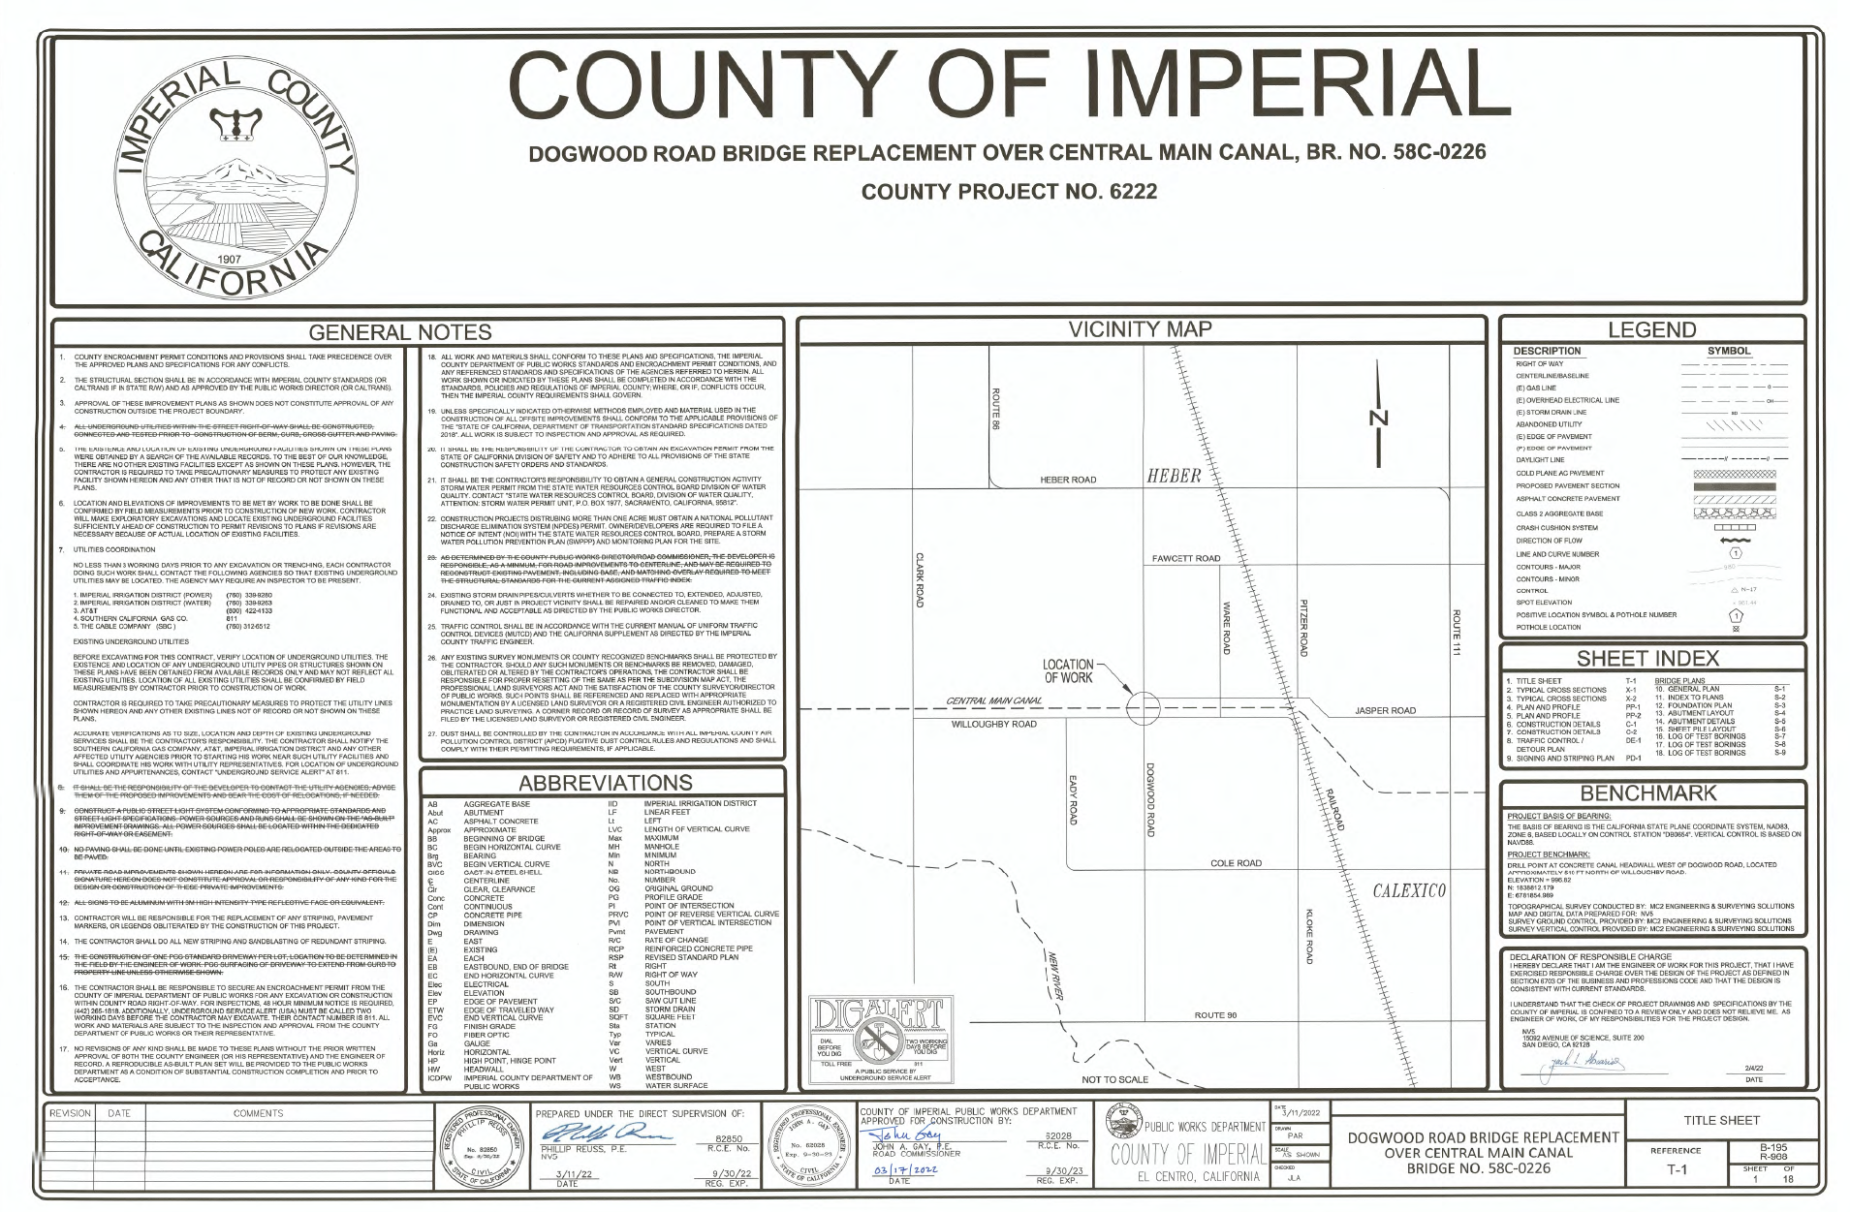

Slide 10
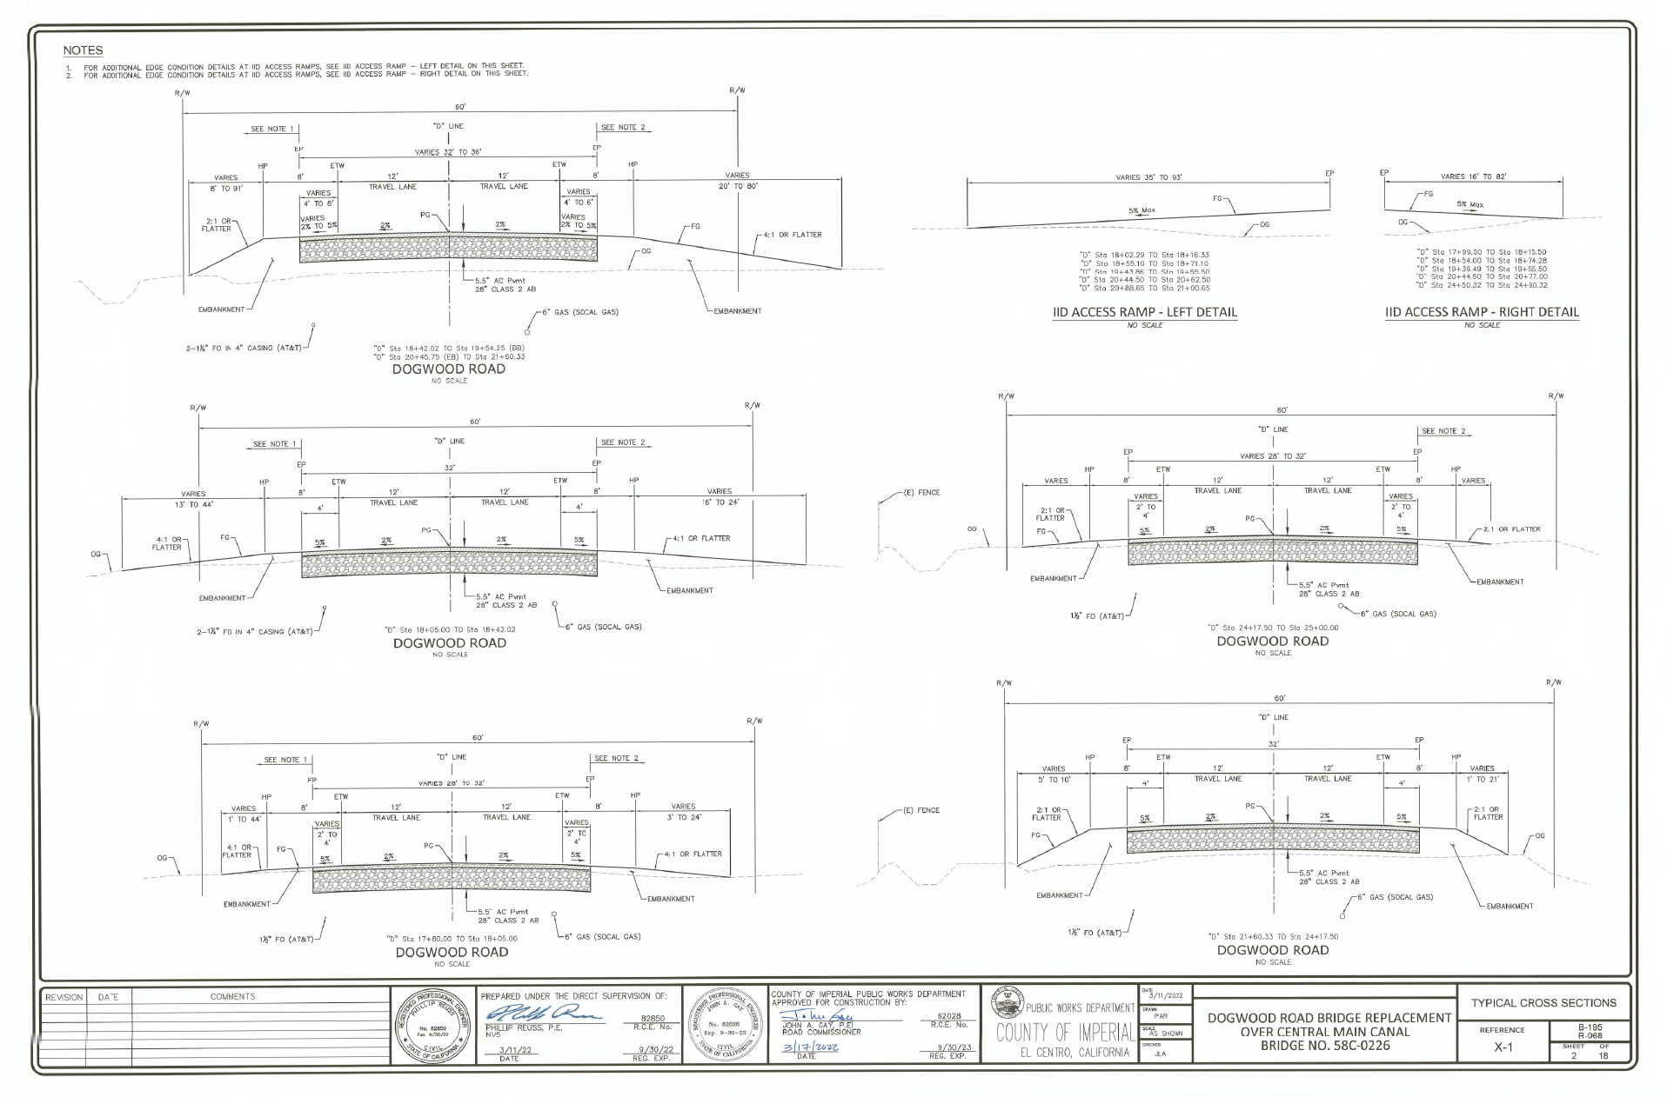

Slide 11
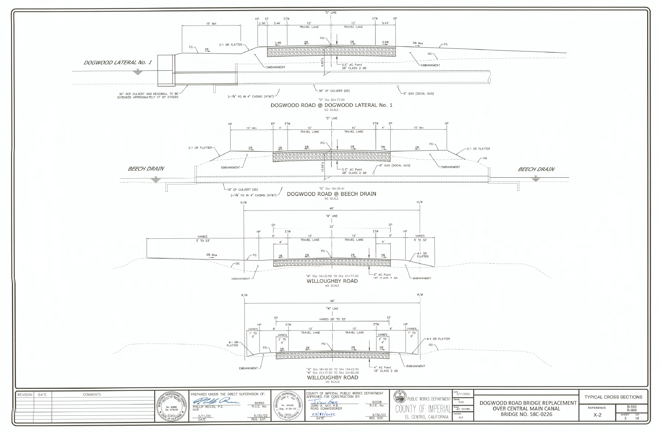

Slide 12
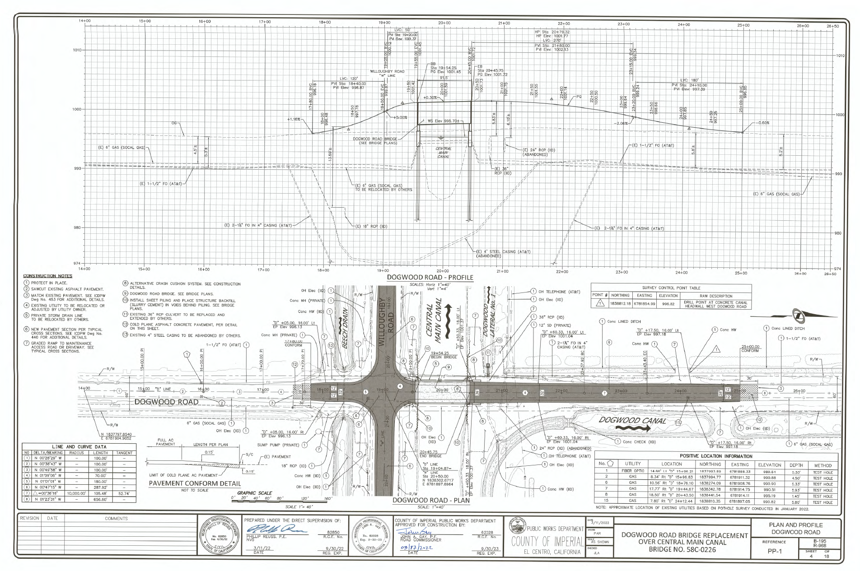

Slide 13
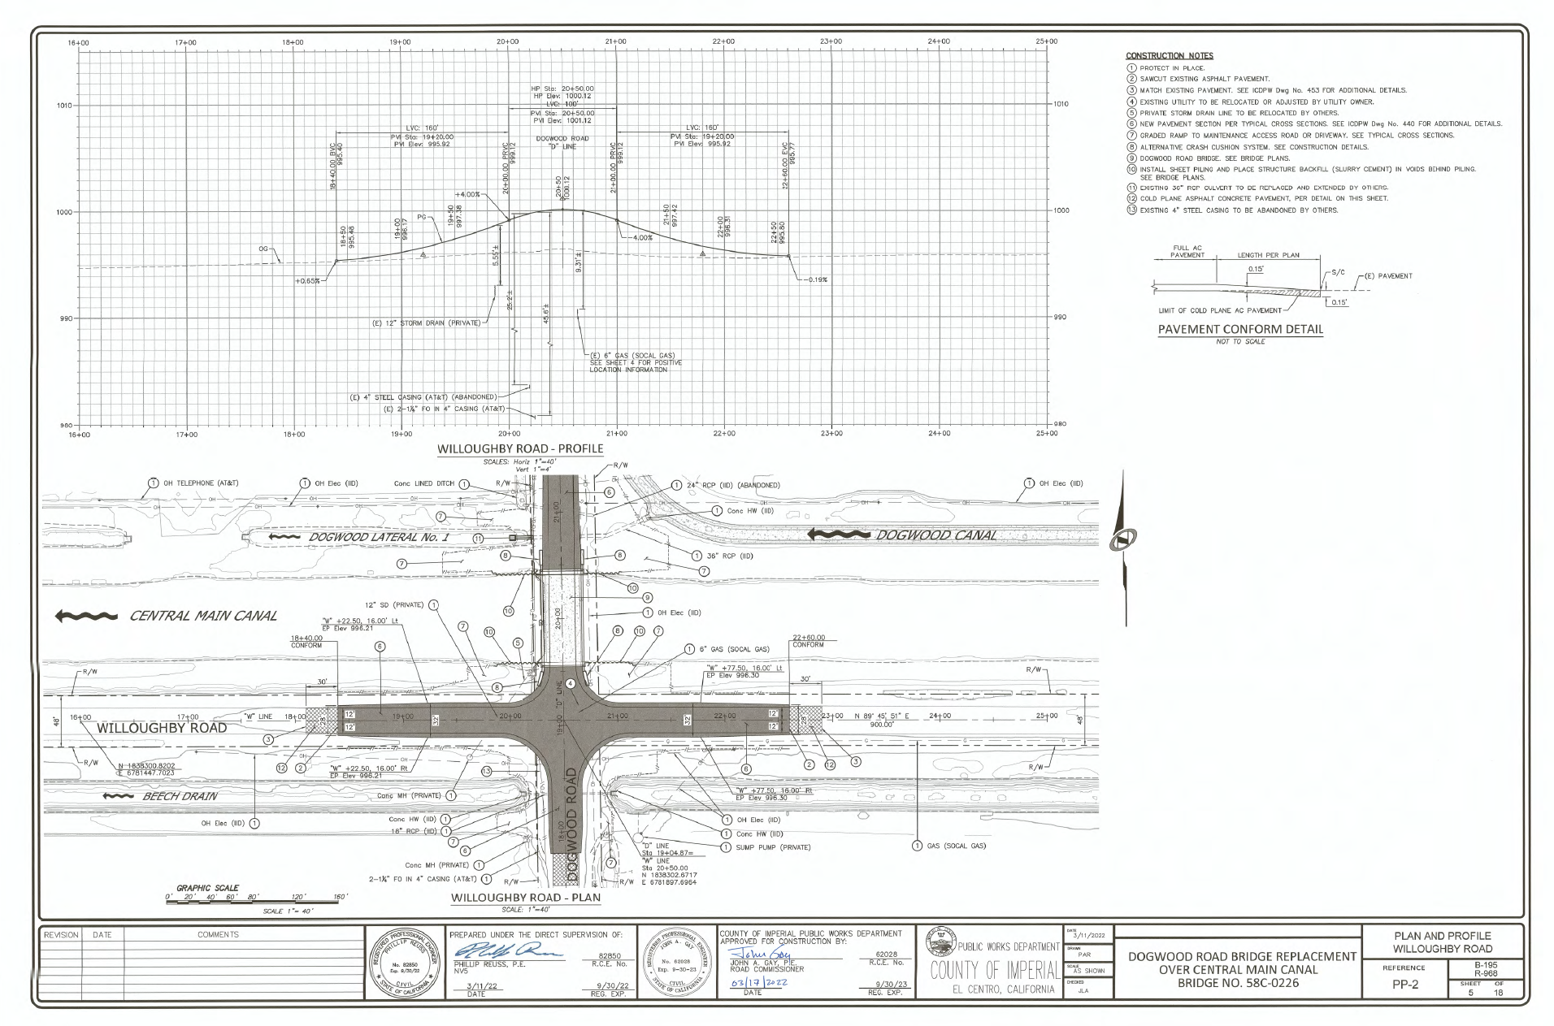

Slide 14
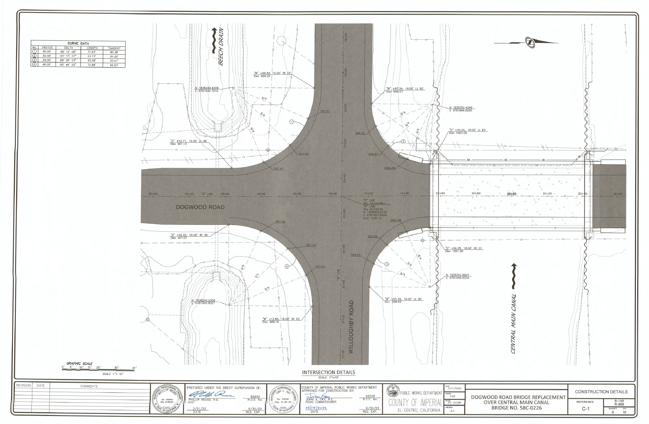

Slide 15
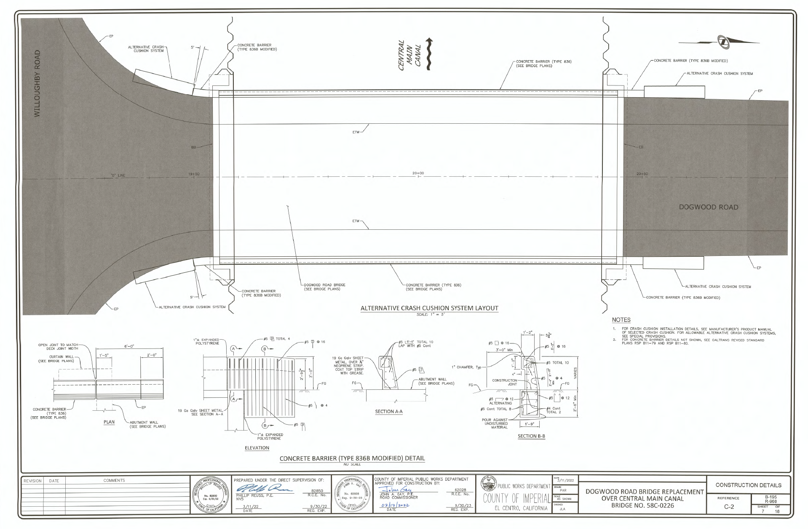

Slide 16
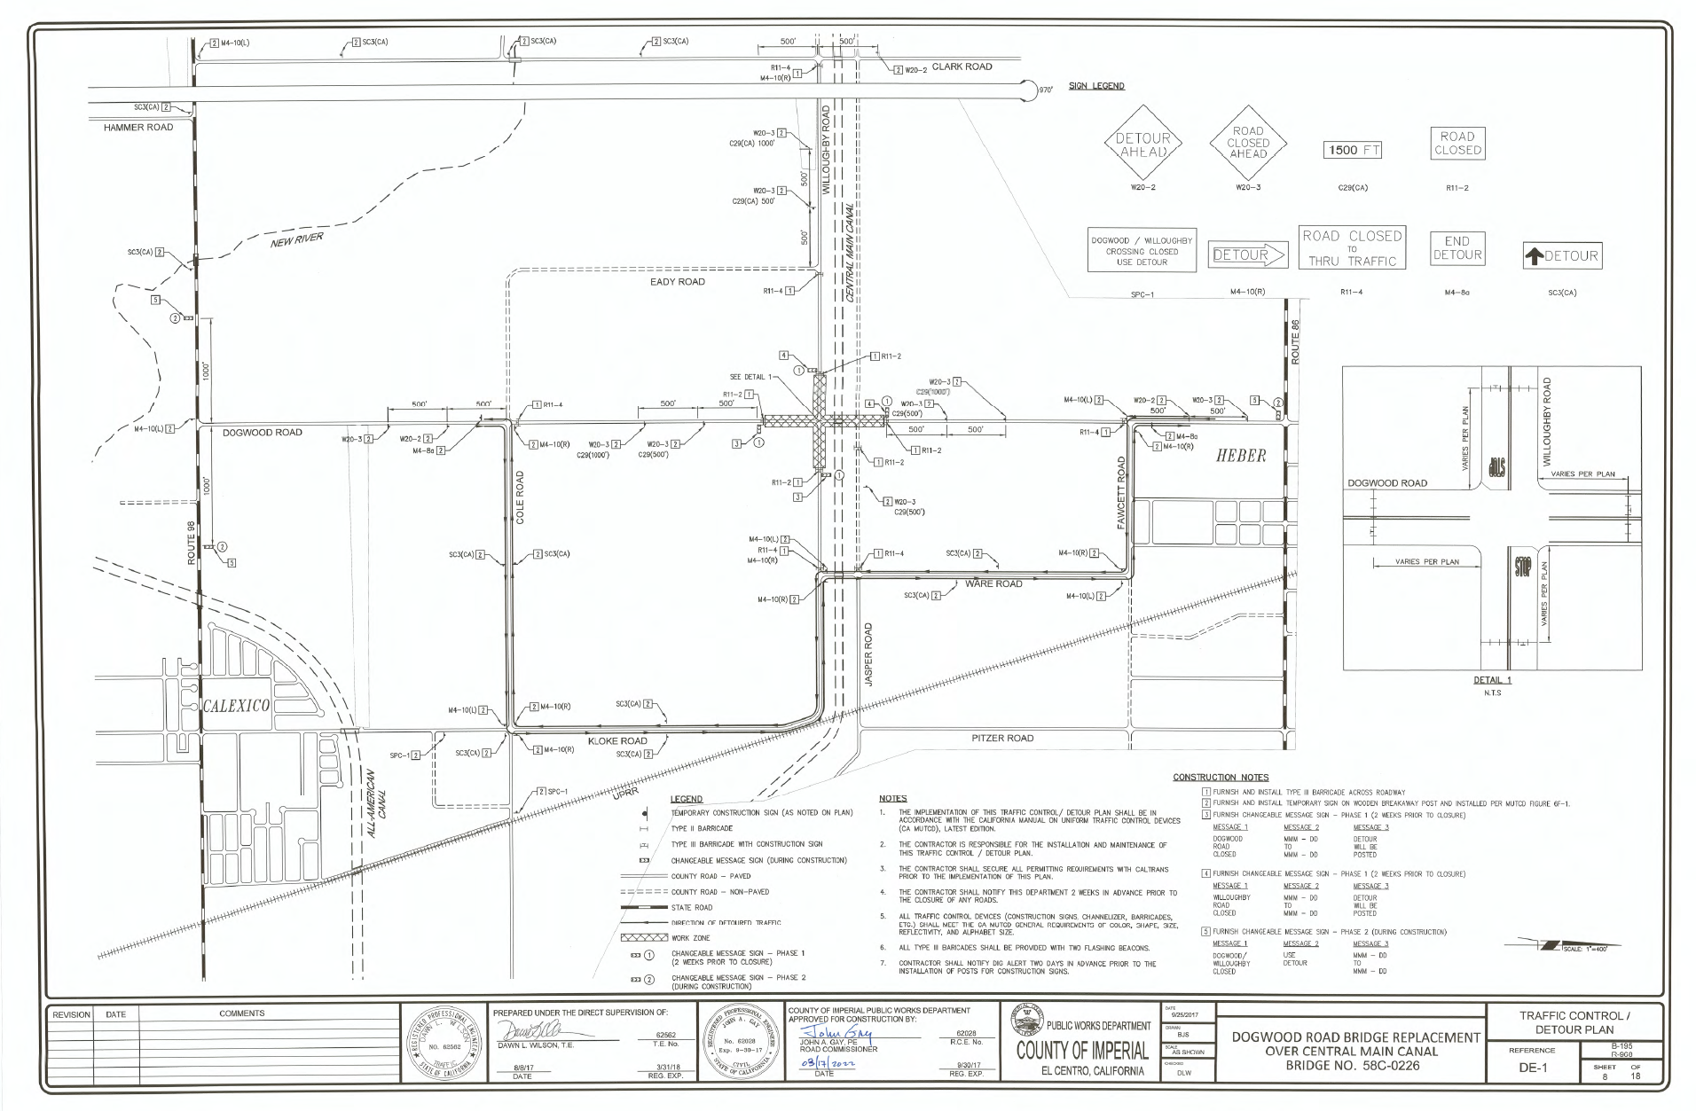

Slide 17
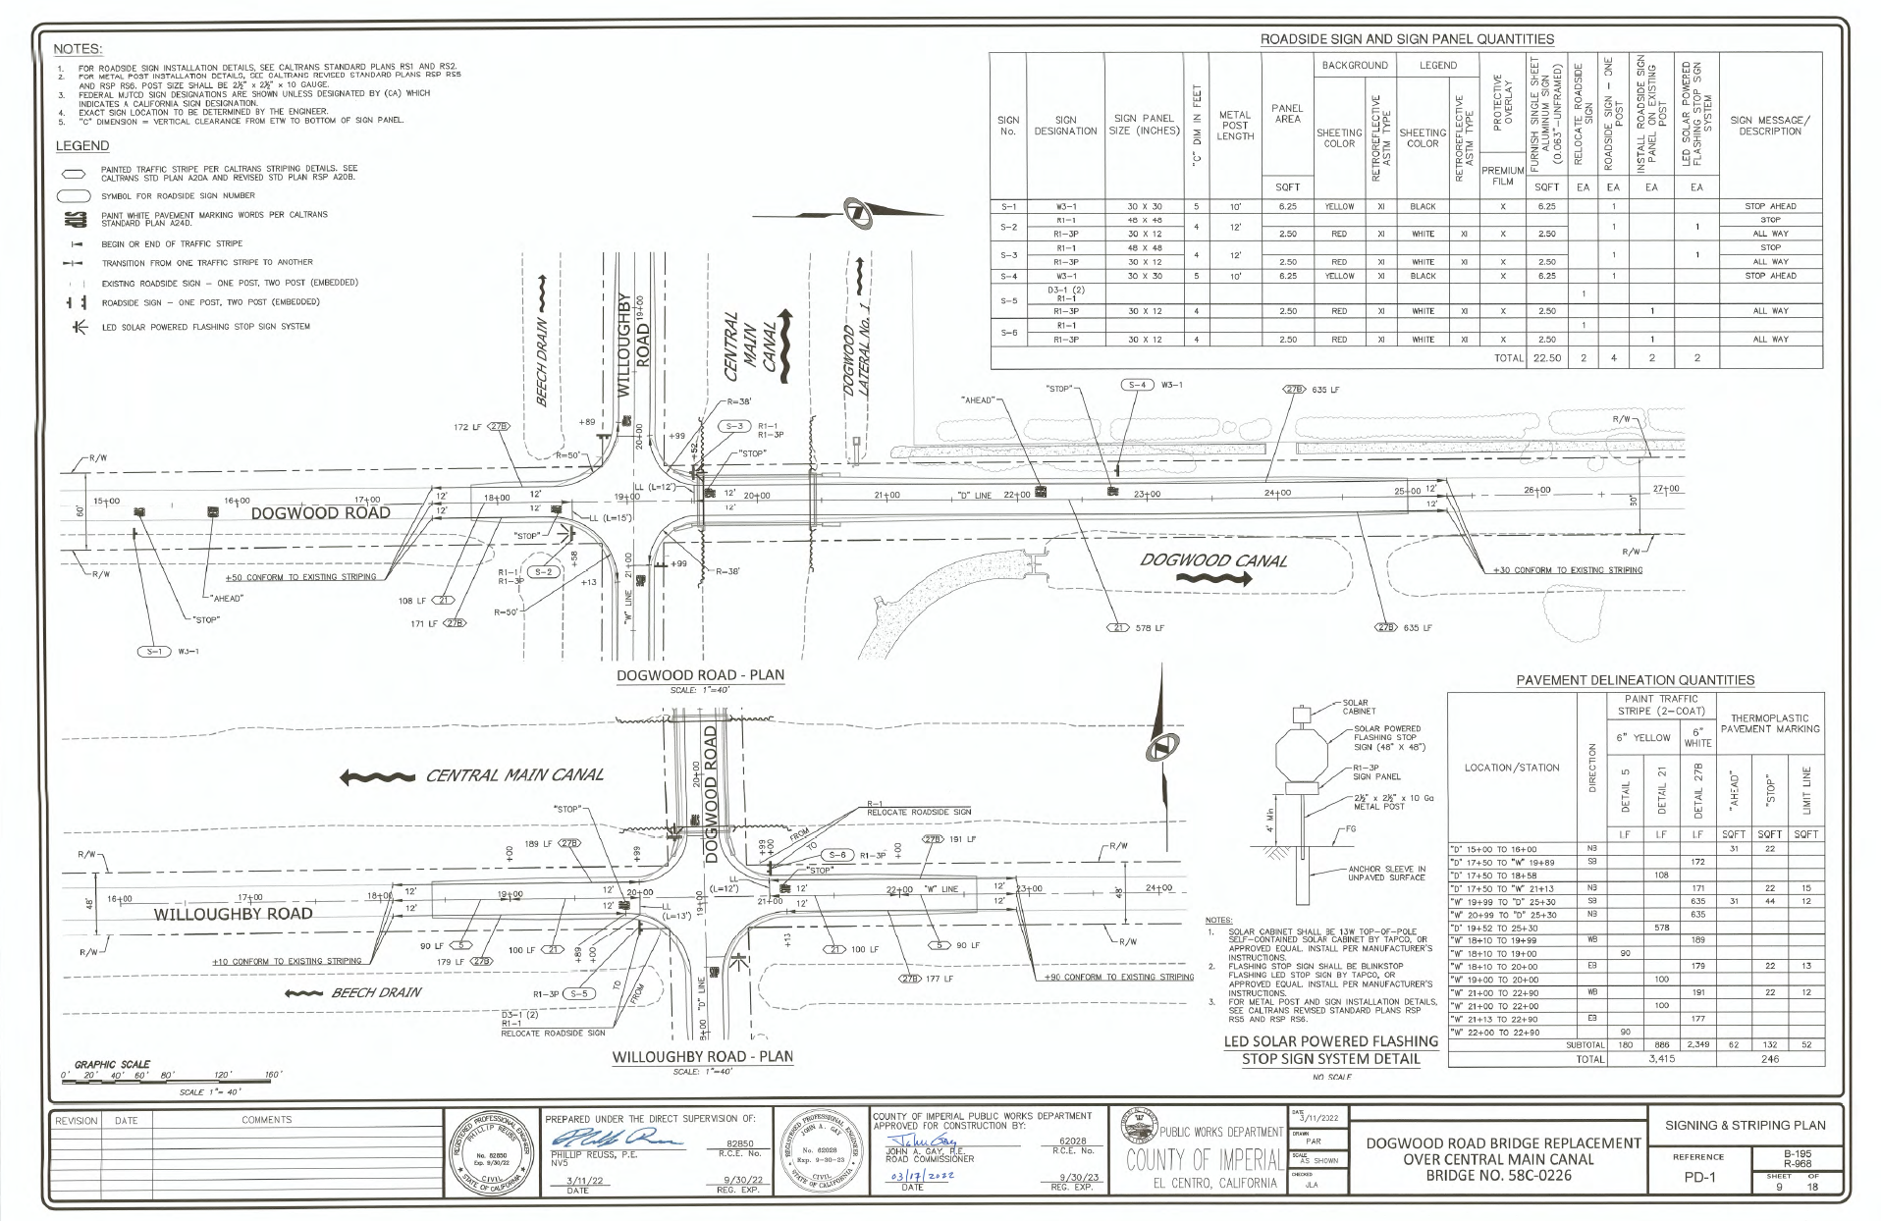

Slide 18
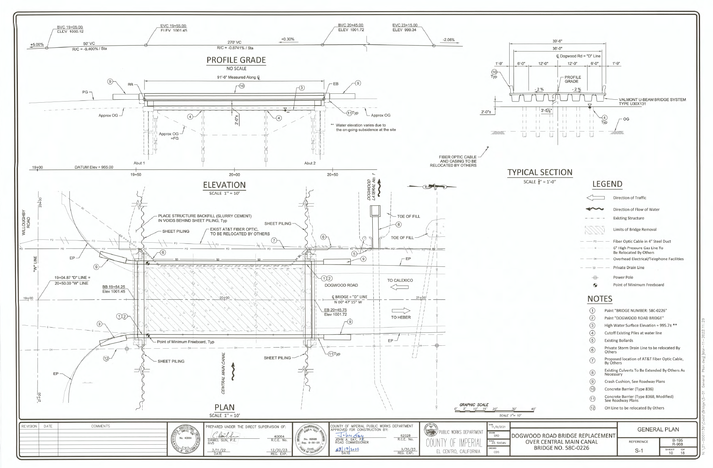

Slide 19
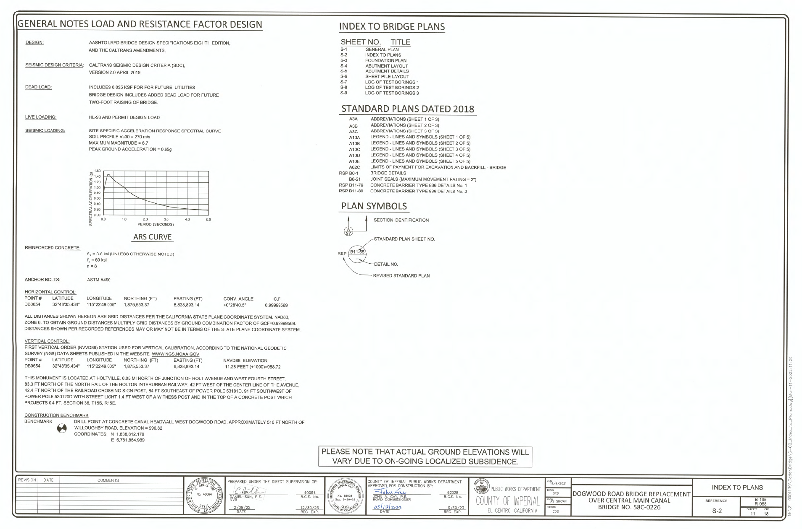

Slide 20
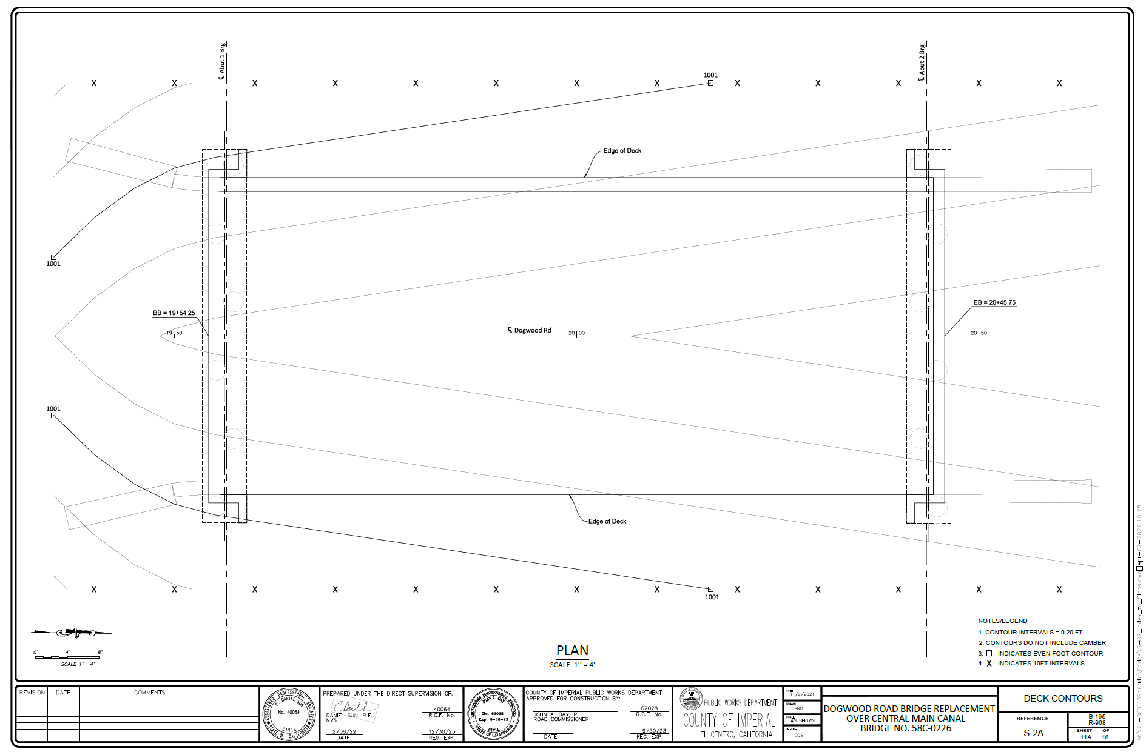

Slide 21
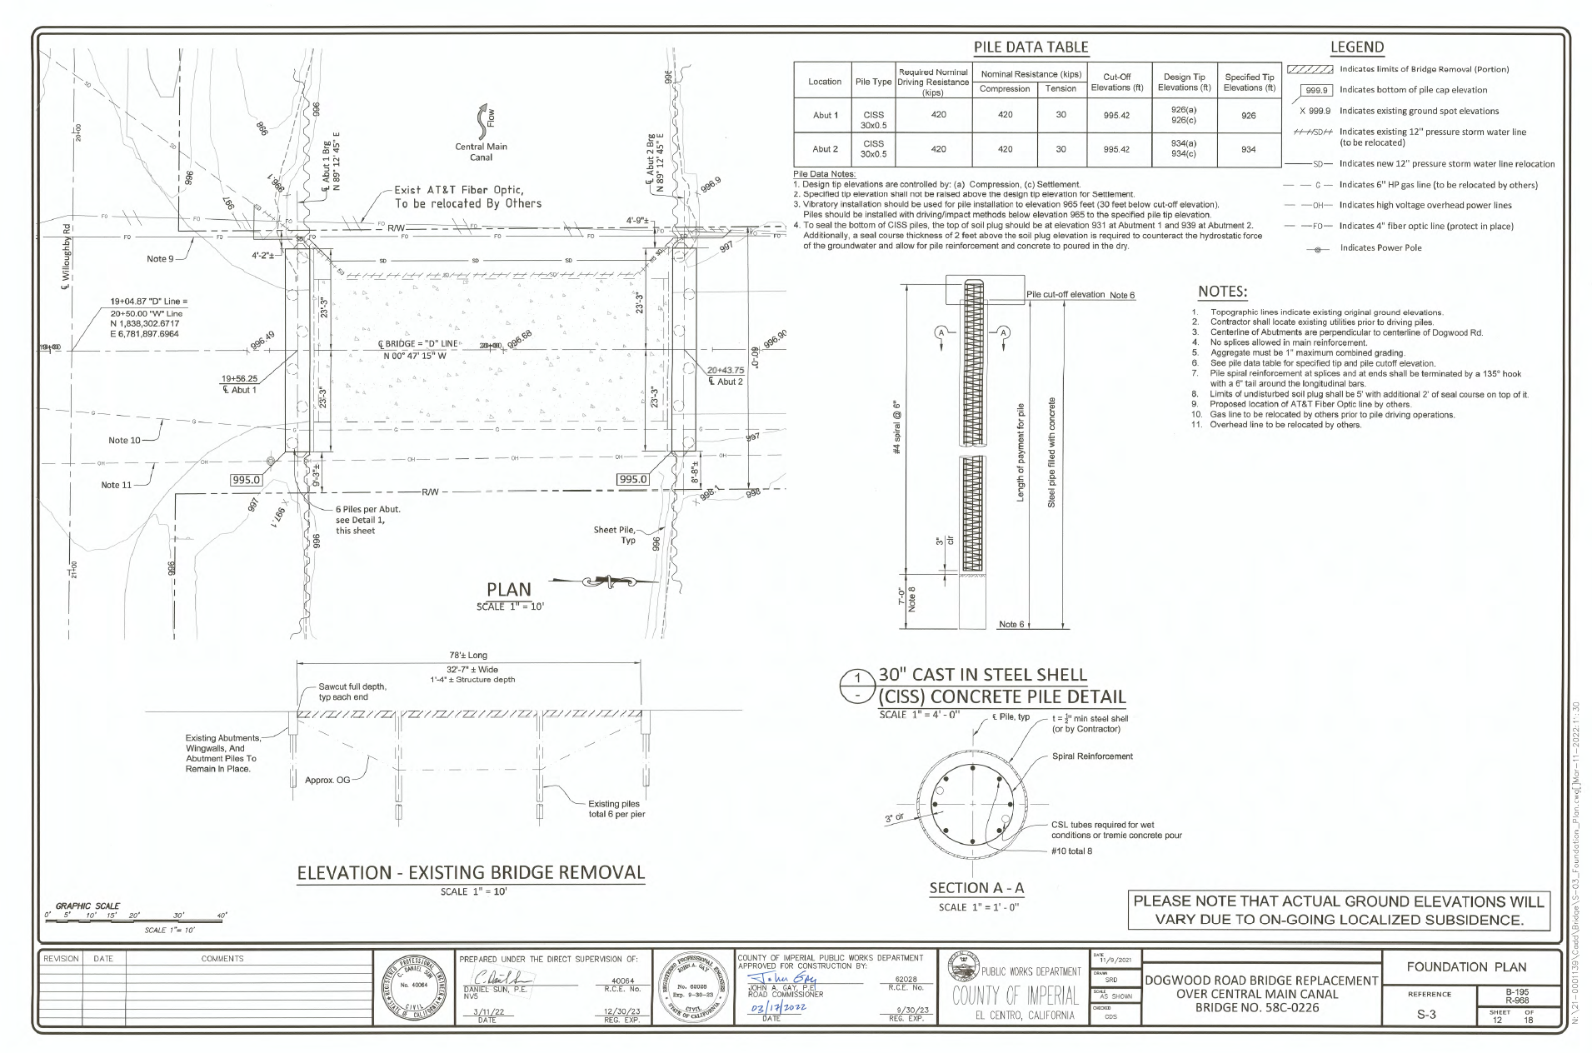

Slide 22
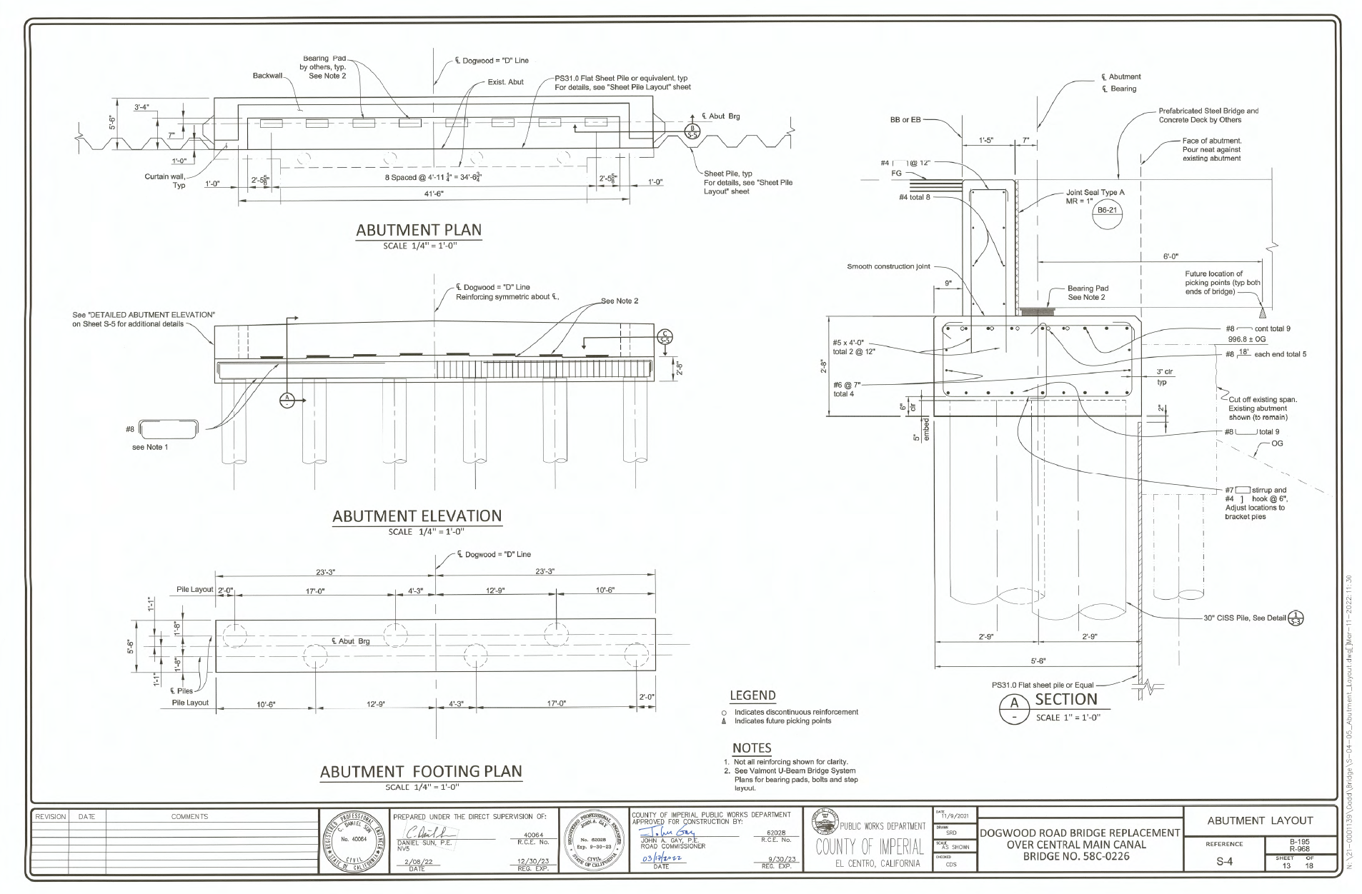

Slide 23
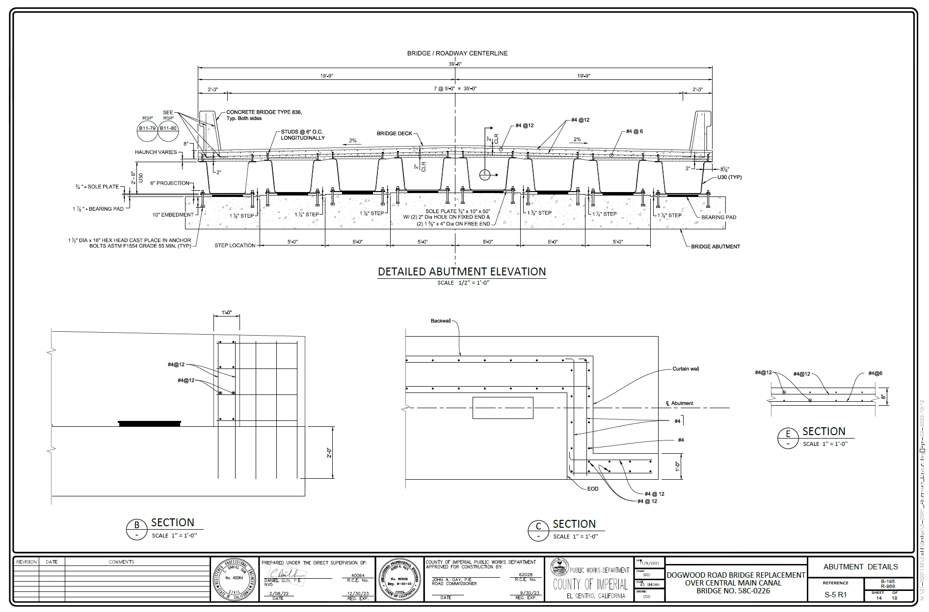

Slide 24
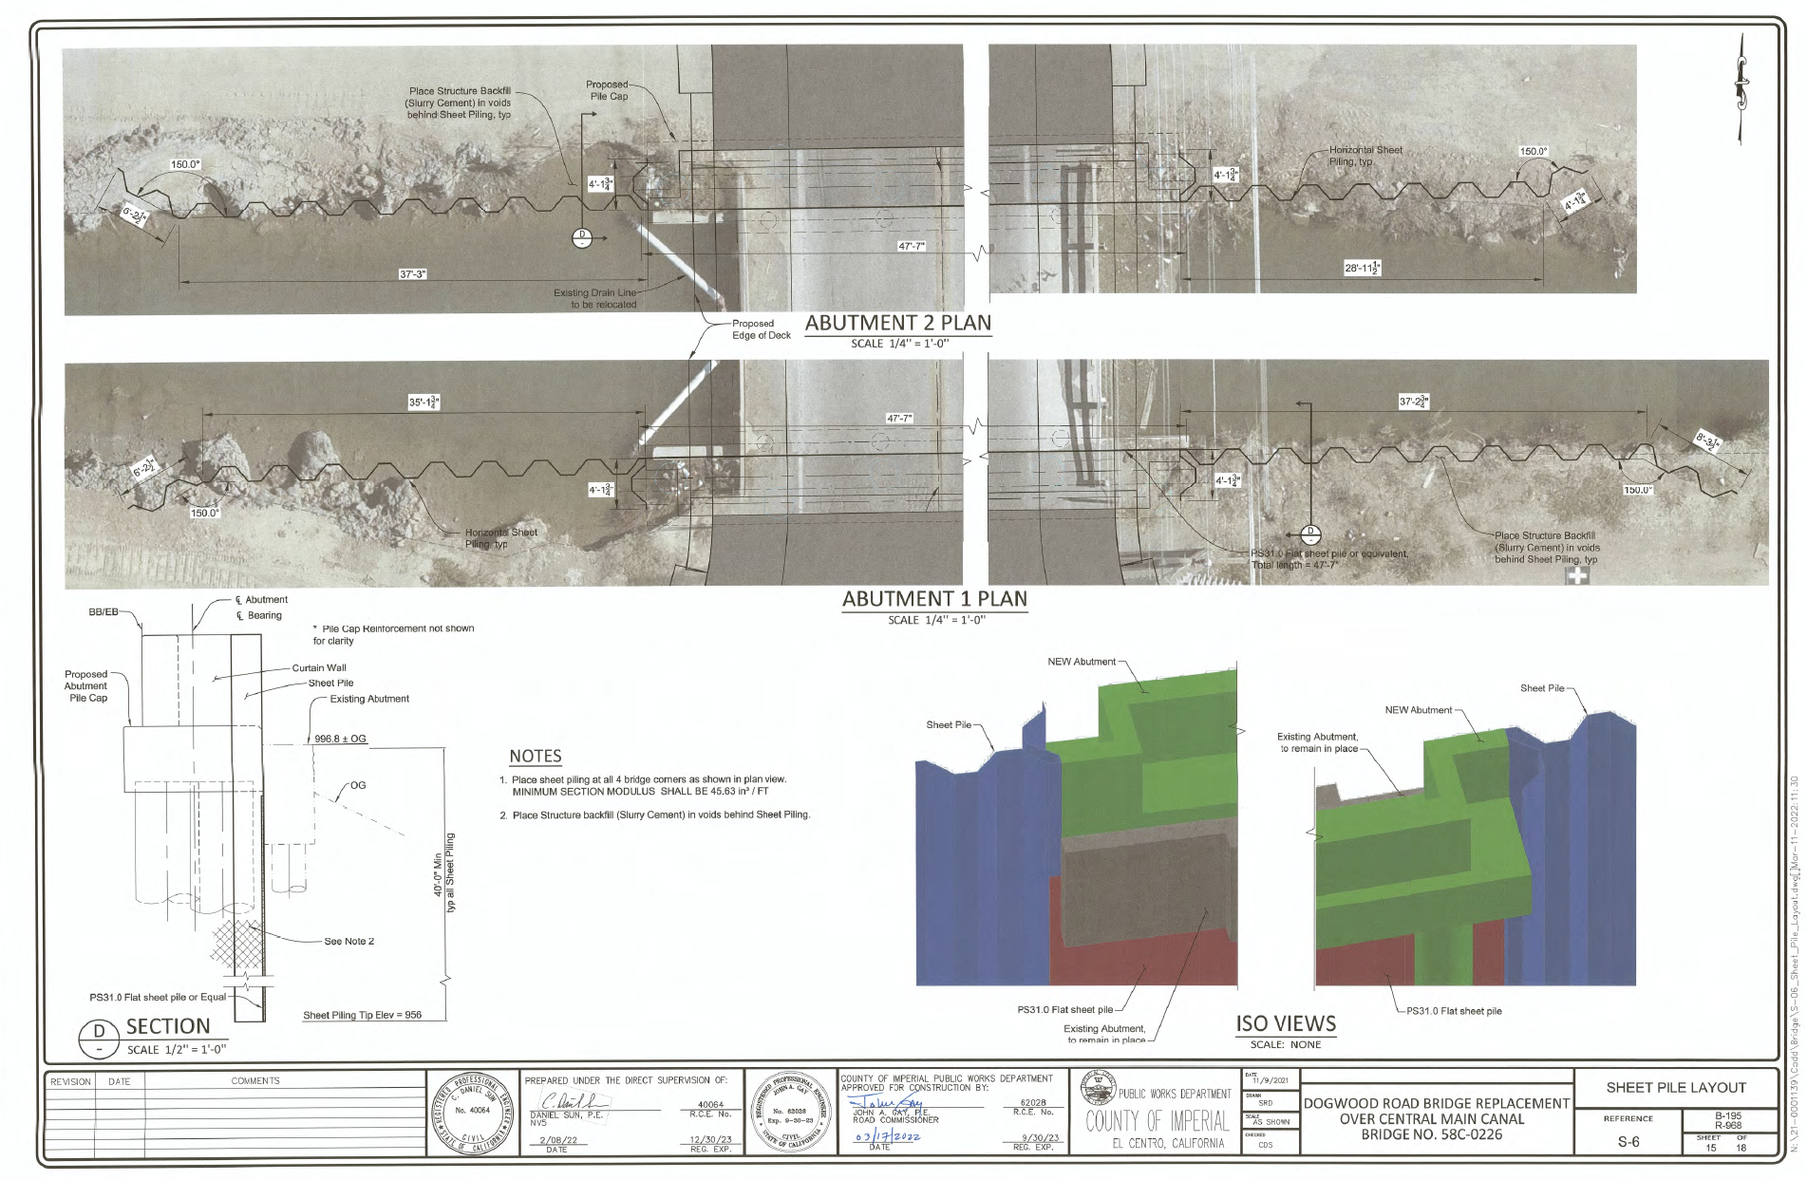

Slide 25
Project Components
Imperial Irrigation District
IID Water : Construction of the extension to the Dogwood Lateral 1 just north of the bridge has been completed
IID Energy: Construction of Shoofly for overhead power lines began on March 28, 2022. Anticipate completion on May 24, 2022.

Slide 26
Project Components
AT&T
Relocation of underground fiber optic line, west side of bridge, has been completed. Existing 4-in steel conduit abandoned in place.
Overhead telecommunication line crossing Dogwood Rd., north of Bridge, to be raised by AT&T. Construction anticipated to start upon completion of IID OH Line Relocation.

Slide 27
Project Components
SoCal Gas: Sequence of Construction
1. Snelson, the contractor for SoCal Gas is to trench and expose the existing 6-in diameter gas pipeline with a 6-ft & 6-in wide excavation on both the north and south side of the existing Dogwood Bridge. The trench walls are to be shored and supported by Snelson, in accordance with OSHA and SoCal Gas requirements throughout the time the trench is exposed. See attached Exhibit B.

Slide 28
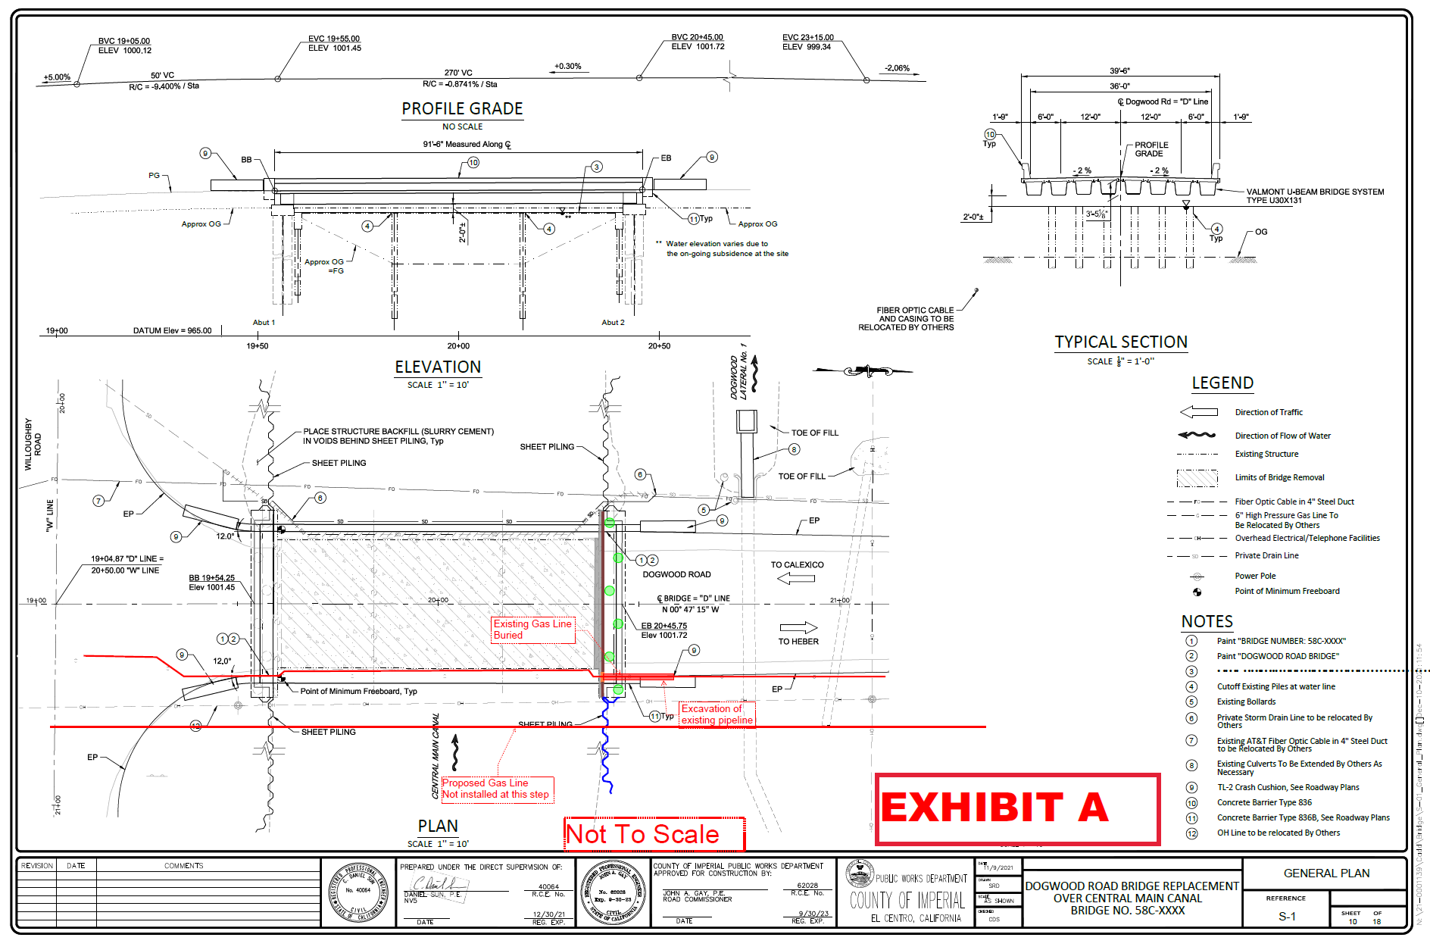

Slide 29
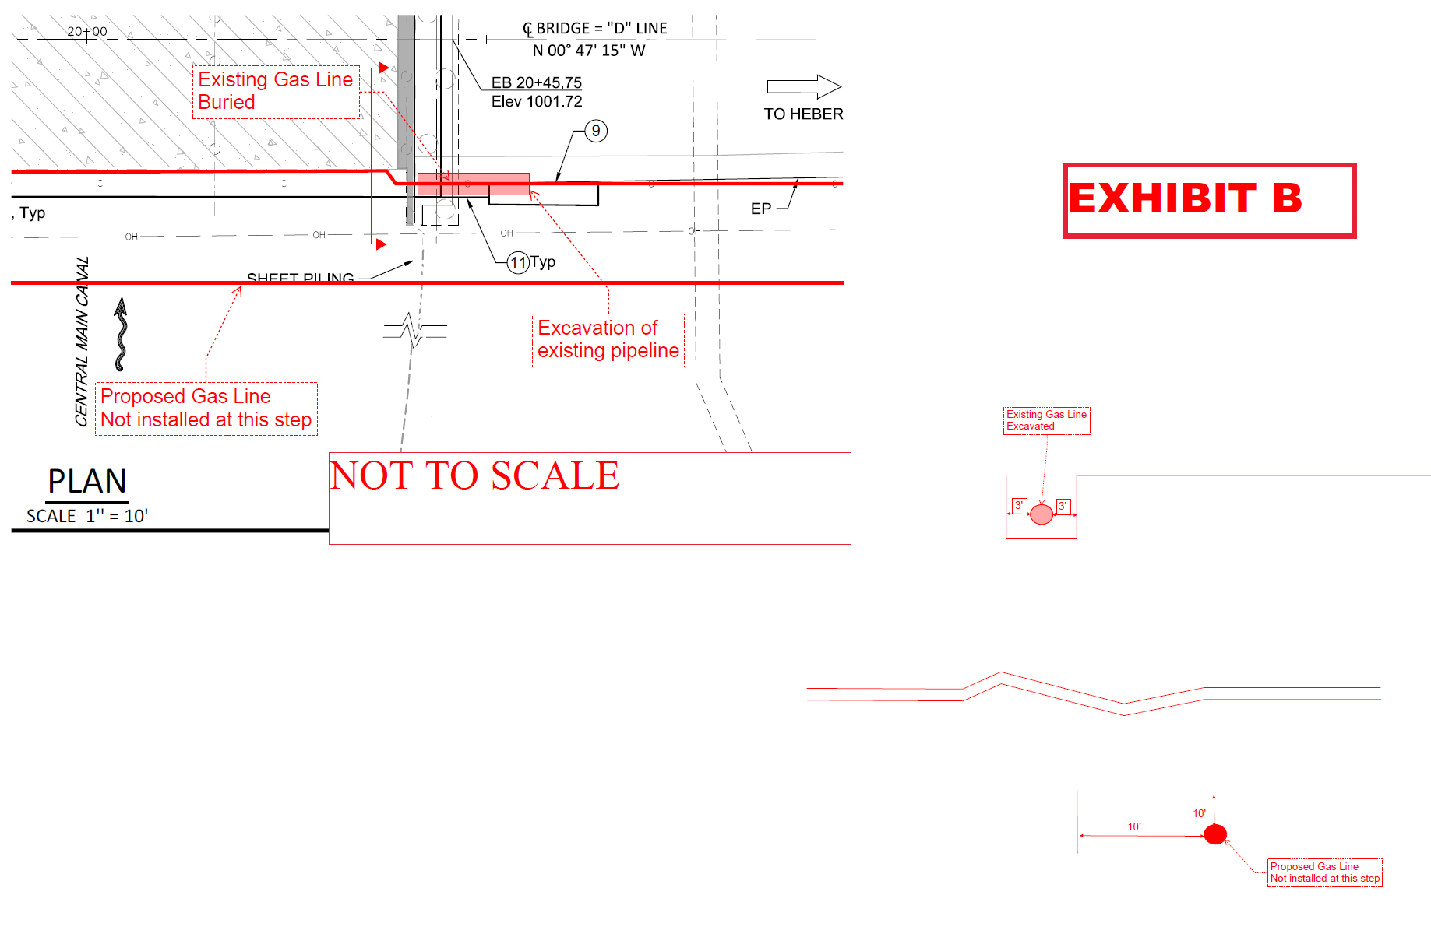

Slide 30
Project Components
SoCal Gas: Sequence of Construction
2. The Contractor shall install sheet piling on the east side of the bridge, on both the north and south part of existing bridge, up to edge of proposed abutment footing. As noted in blue per attached Exhibit C

Slide 31
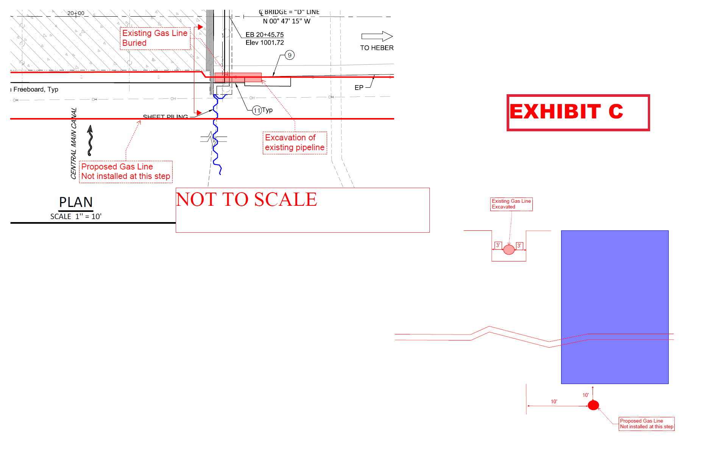

Slide 32
Project Components
SoCal Gas: Sequence of Construction
3. The Contractor shall install flat sheet piling on both the north and south of the bridge, up to the edge of the trench of the existing gas pipeline. As noted in brown per attached Exhibit D. The flat sheet piling shall be properly connected to the other sheet piling.

Slide 34
Project Components
SoCal Gas: Sequence of Construction
4. The Contractor shall predrill the nearest three (3) abutment piles, from the existing gas pipeline on both the north and south sides of the bridge. The piles are to be predrilled to -15 feet depth below the existing grade. As noted in green per attached Exhibit E

Slide 35
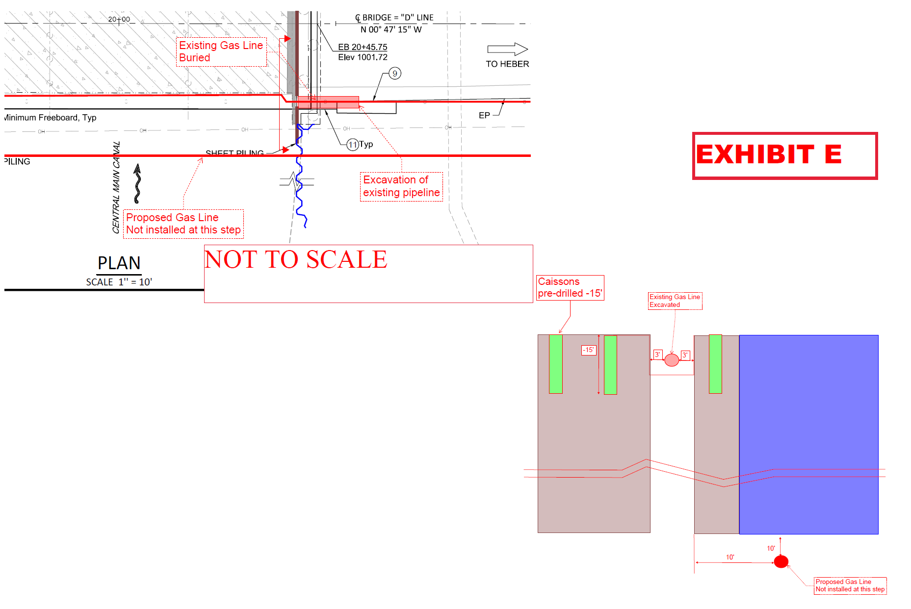

Slide 36
Project Components
SoCal Gas: Sequence of Construction
5. The Contractor shall drive the steel shells for the nearest three (3) predrilled abutment piles from the existing gas pipeline on both the north and south sides of the bridge. The three (3) steel shells are to be driven to their design tip elevation. As noted in green per attached Exhibit F.

Slide 37
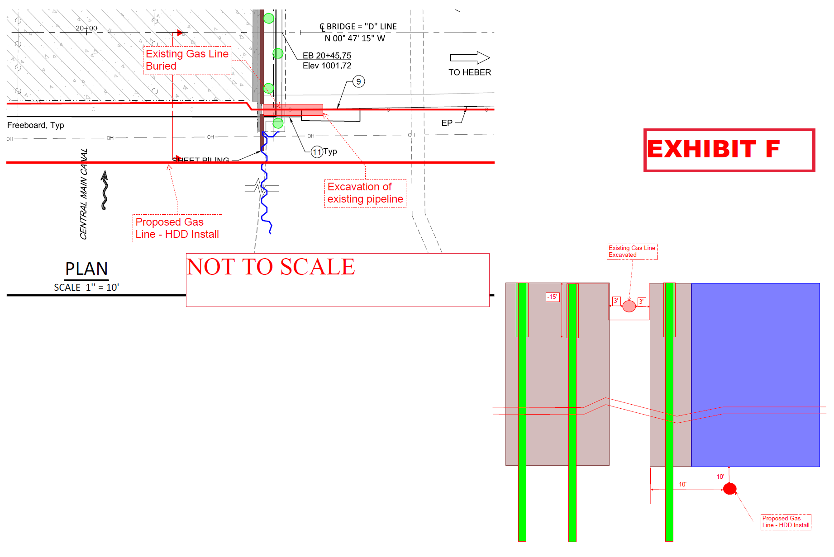

Slide 38
Project Components
SoCal Gas: Sequence of Construction
6. Snelson is to conduct Horizontal Direction Drilling (HDD) underneath the sheet piling on the east side of the bridge for the new gas pipeline. See attached Exhibit G

Slide 39
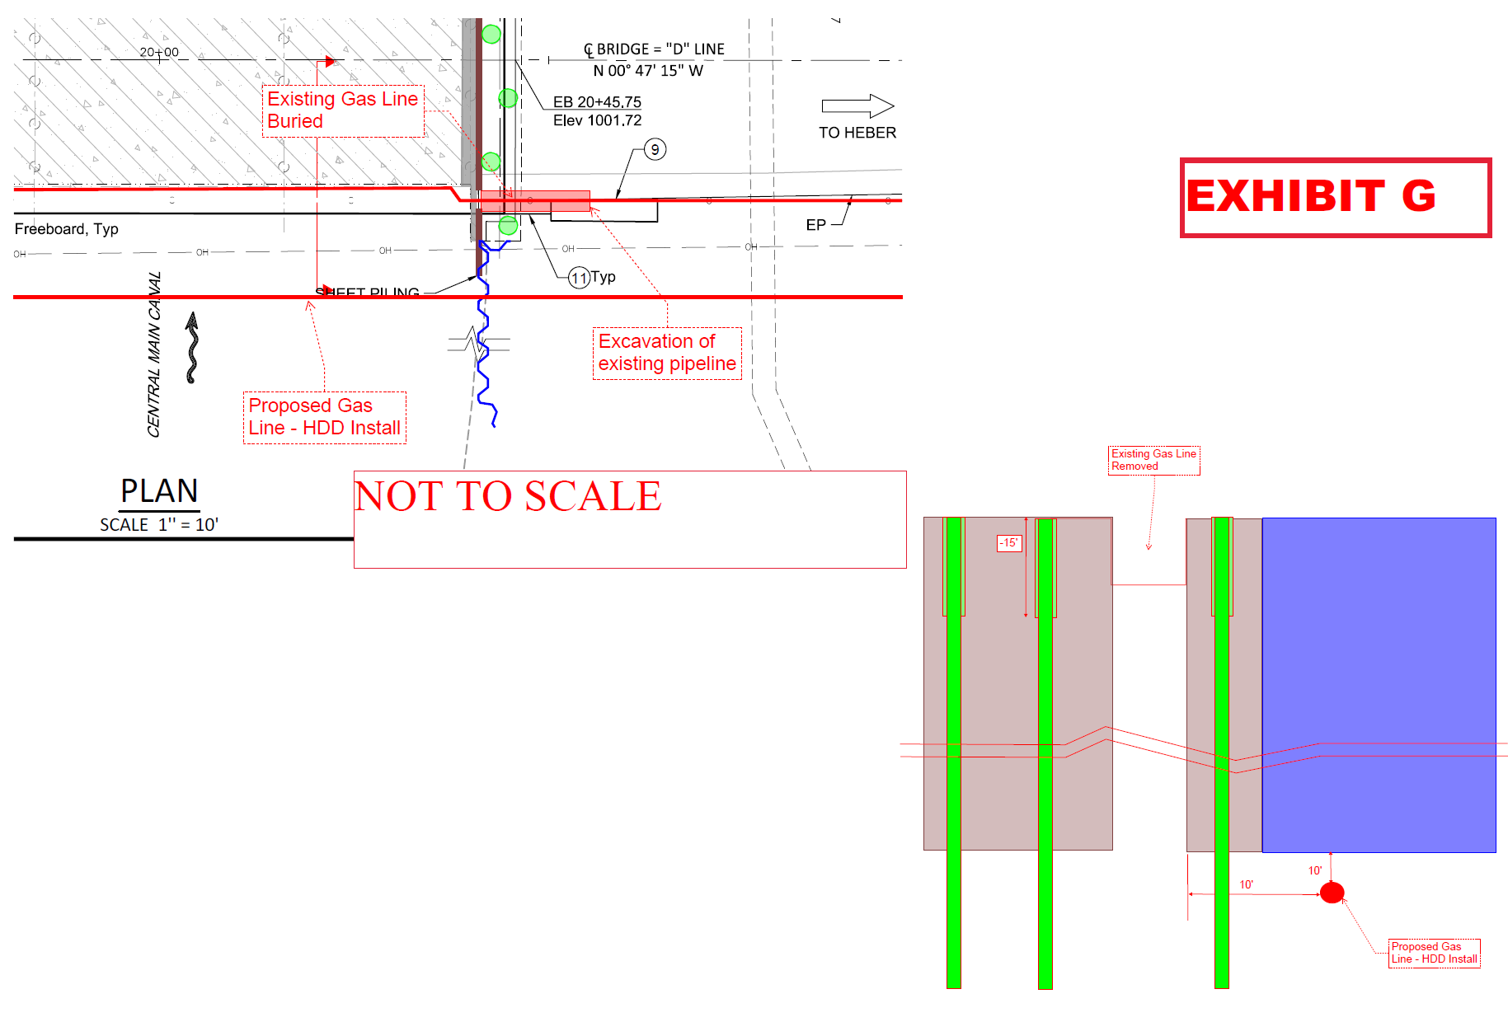

Slide 40
Project Components
SoCal Gas: Sequence of Construction
7. Snelson and SoCal Gas to conduct tie-in of the new 6-inch gas pipeline to existing 6-inch gas pipeline on both the north and south side of the bridge
8. Snelson and SoCal Gas to purge and remove the existing gas pipeline at the bridge

Slide 41
Project Components
SoCal Gas: Sequence of Construction
9. Contractor is to install the remaining sheet piles and flat piles along the west side of the bridge, while Snelson installs the new gas pipeline along the east side of the bridge. Contractor is to also complete installation of the remaining CISS piles, while Snelson installs the new gas pipeline along the east side of the bridge.

Slide 42
Project Components
SoCal Gas: Sequence of Construction
10. Contractor is to install the remaining flat sheet piles along the east side of the bridge after the removal of the existing gas pipeline. See attached Exhibit H.

Slide 43
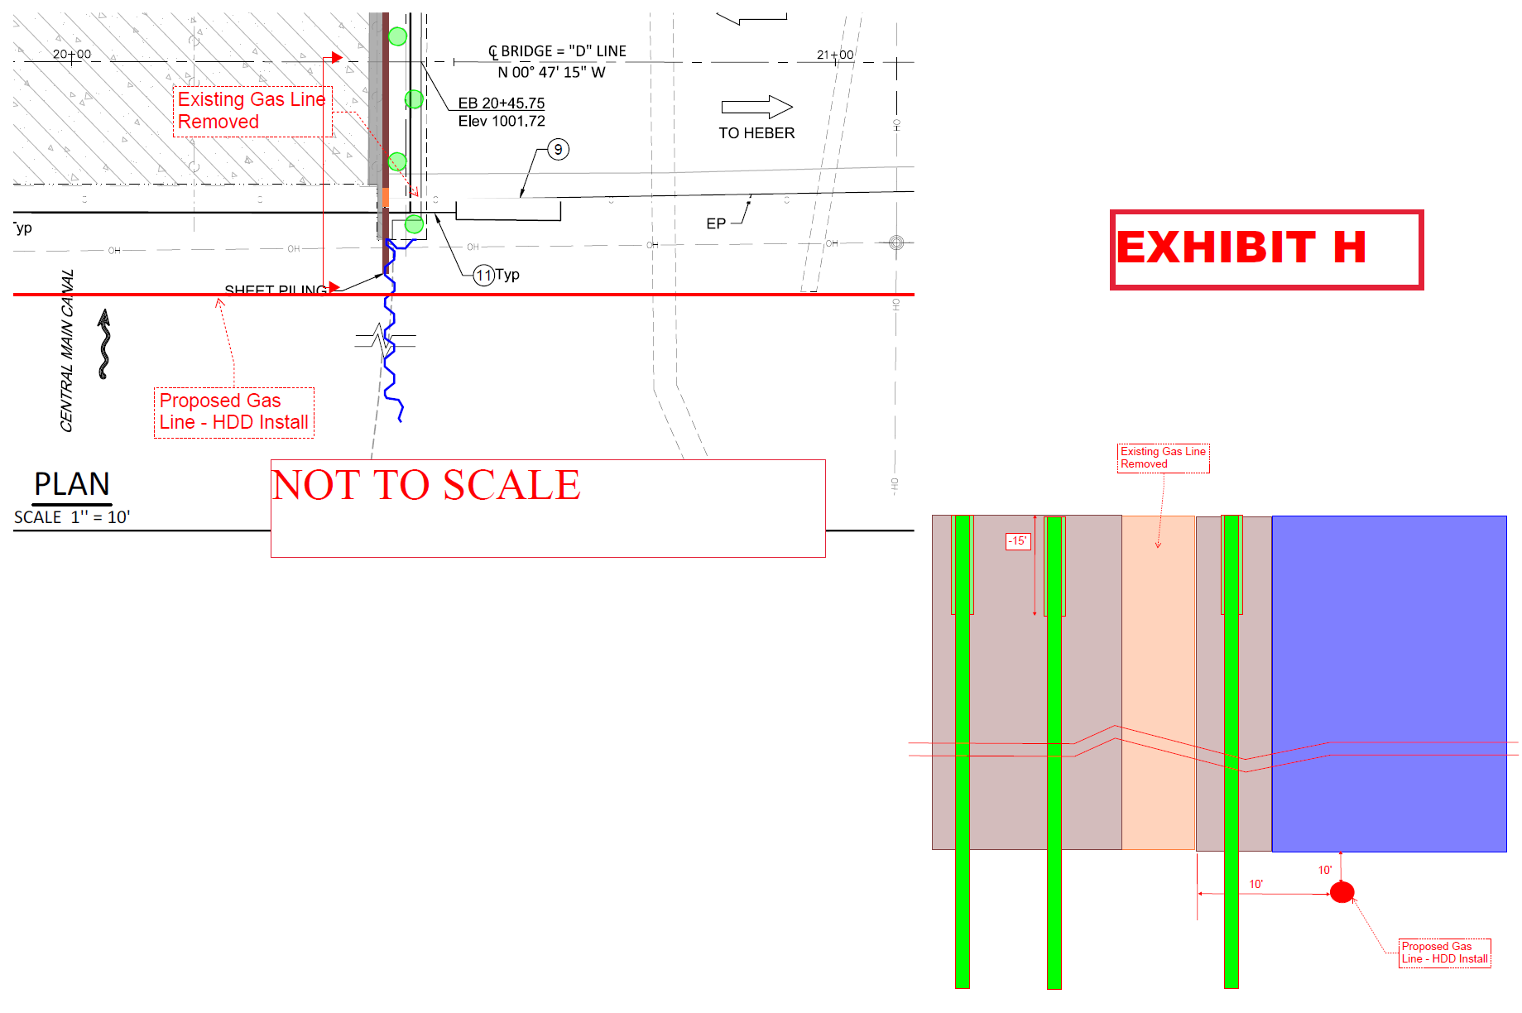

Slide 44
Project Components
SoCal Gas: Sequence of Construction
11. Contractor is to demolish the existing bridge deck per the approved demolition sequence, and install the new bridge.

Slide 45
Project Components
SoCal Gas: Sequence of Construction
Additional Notes:
Per Snelson the installation of the new gas pipeline would take about 42 working days to be completed, including tie-in of the new gas pipeline to the existing gas pipeline at both ends, and removal of the existing gas pipeline.
A representative of SoCal Gas and Snelson is to be present at the project site throughout the duration of construction

Slide 46
Additional Request for Information
1. Provide two proposed schedules (i.e. Project Gantt Chart Schedule) indicating how the project will be constructed. One schedule will be based on the 7-day construction workday calendar (including legal holidays) and the other schedule will be based on the 5-day construction workday calendar (i.e. no weekends and legal holidays).
Note: SoCal Gas construction sequencing shall be included in the proposed schedules.

Slide 47
Additional Request for Information
2. How long would it take for your firm to procure and deliver steel foundation piles and sheet piles to the project site?
3. Provide a List of Bridge Projects your firm has completed in the last five (5) years
4. Has your firm, team members, or subcontractors built Steel Bridges in the last 10 years? If so, please provide a list of projects.

Slide 48
Questions / Open Discussion

Slide 49
Site Walk

